Slide 1
Analytical Engineering
Foster Provost

Slide 2

Recall:
Specifically, your task is to help Henrietta devise a precise, step-by-step plan for how the analyst/tech team should use MegaTelCo’s vast data resource to decide which customers to target with the special retention offer prior to them paying off their phones.
Be specific as to what data to use and how to use them, and specifically how the team should decide on the set of customers to target to best reduce churn for a particular incentive budget. Use your better judgment as to what data MegaTelco would have.
Henrietta, a Data Science Product Manager, has just joined MegaTelCo, one of the largest telecommunication firms. MegaTelco is having a major problem with churn in their wireless business. In the mid-Atlantic region, 20% of cell-phone customers leave when their phones are paid off, and it is getting increasingly difficult to acquire new customers. They call her in to help understand the problem and devise a solution. Marketing has designed a special retention offer.
So: What should be your first step?
Notes:
Lots of variance in your answers to this from the pre-class exercise. Let’s focus on just this one thing: what should be our first step? Get together and see what your groups decide.

Slide 3
Recall:
Specifically, your task is to devise a precise, step-by-step plan for how the product should use MegaTelCo’s vast data resource to decide which customers to target with the special retention offer prior to the expiration of their contracts.
Consider just one special offer that Marketing devised last week. Be specific as to what data to use and how to use them, and specifically how we should decide on the set of customers to target to best reduce churn for a particular incentive budget. Use your better judgment as to what data you would have access to at MegaTelco.
You just joined MegaTelco, one of the largest telecommunication firms, as an “AI” Product Manager. Your responsibility is to oversee a new data-driven product to help MegaTelco with its ongoing challenge of churn in their wireless business. This product is focusing specifically on the fact that many cell-phone customers leave when their contracts expire, and it is getting increasingly difficult to acquire new customers. The Marketing department designs special retention offers. This new product will efficiently target these offers to the right customers, to better manage retention.
So: What should be your first step?
Notes:
Lots of variance in your answers to this from the pre-class exercise. Let’s focus on just this one thing: what should be our first step? Get together and see what your groups decide.

Slide 4
Can we identify complications with our initial solution to the MegaTelco problem?
The solution is not simply to target customers ranked by likelihood to churn.

Slide 5




Attrition Management Complications . . . ?
If there is a non-negligible cost of making the offer, are we wasting a lot on people who are "lost causes"?
What about people who would have stayed anyway, but then take the offer and that costs us?
What about sleeping dogs -- who would have stayed, but leave because of the offer?
Customer value: Wouldn’t we we care more about some people churning? Maybe we even would like some to churn...?
What if we have a targeting budget?
Crazy, I know, but … should we offer different offers to different people?
Notes:
Help us to be more systematic when we face biz challenges and opps. The challenges faced are often complex – the frameworks help us to break these down into more manageable pieces and also to know what order to address the pieces.
2 are sure things

Slide 6
Here is our “expected value” framework for a binary action:
take action on instance x if:
EV(act on x) > EV(don’t act on x)
Notes:
When we apply the EV framework, a key part of our business understanding is to lay out the benefits and costs....

Slide 7
How can we define our benefit matrix?
Key complication:
More of the cells of our benefit matrix may be non-zero.
benefit/cost matrix
Stay
Leave
T for “Target”
T
v(x,T,S)-c
v(x,T,L)-c
N
v(x,N,S)
v(x,N,L)

Slide 8
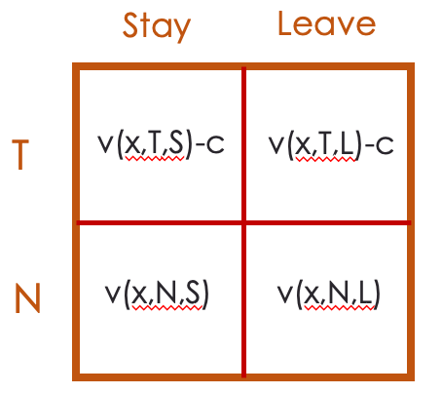
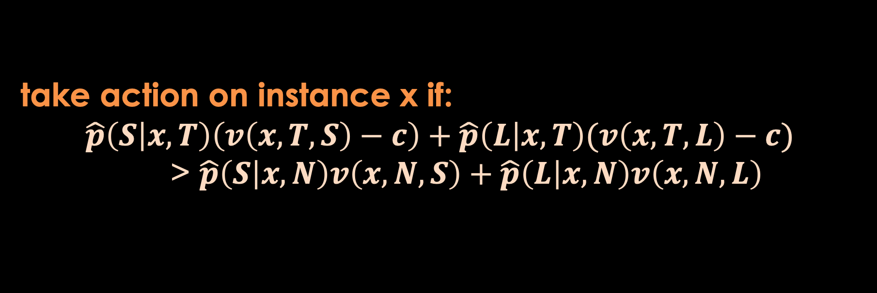
Here is the “expected value” framework for a binary action:
take action on instance x if:
EV(act on x) > EV(don’t act on x)
take action on instance x if:
$$\hat{p}\left(S | x,T\right)\left(v\left(x, T, S\right)−c\right)+\hat{p}\left(L | x,T\right)(v\left(x,T,L\right)−c)$$
> $\hat{p}\left(S | x,N\right)v\left(x, N, S\right)+\hat{p}\left(L | x,N\right)v\left(x,N,L\right)$

Slide 9
Here is the “expected value” framework for a binary action:
take action on instance x if:
EV(act on x) > EV(don’t act on x)
v(x)-c
-c
take action on instance x if:
$$\hat{p}\left(S | x,T\right)\left(v\left(x, T, S\right)−c\right)+\hat{p}\left(L | x,T\right)(v\left(x,T,L\right)−c)$$
> $\hat{p}\left(S | x,N\right)v\left(x, N, S\right)+\hat{p}\left(L | x,N\right)v\left(x,N,L\right)$
v(x)
0
Let’s make some assumptions about the costs & benefits

Slide 10
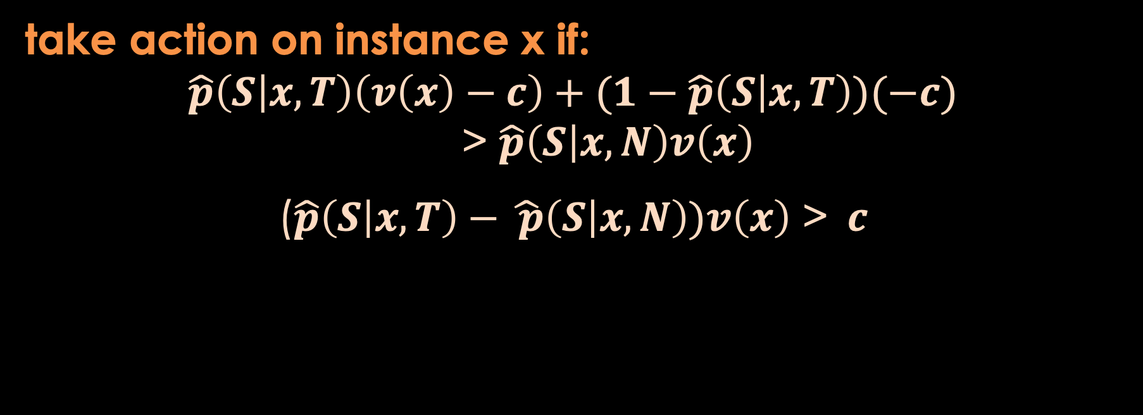
Here is the “expected value” framework for a binary action
take action on instance x if:
EV(act on x) > EV(don’t act on x)
v(x)-c
-c
v(x)
0
take action on instance x if:
$$\hat{p}\left(S | x,T\right)\left(v\left(x\right)−c\right)+(1−\hat{p}\left(S | x,T\right))(−c)$$
> $\hat{p}\left(S | x,N\right)v\left(x\right)$
($\hat{p}\left(S | x,T\right)−\hat{ p}\left(S | x,N\right))v\left(x\right)$ >$c$

Slide 11
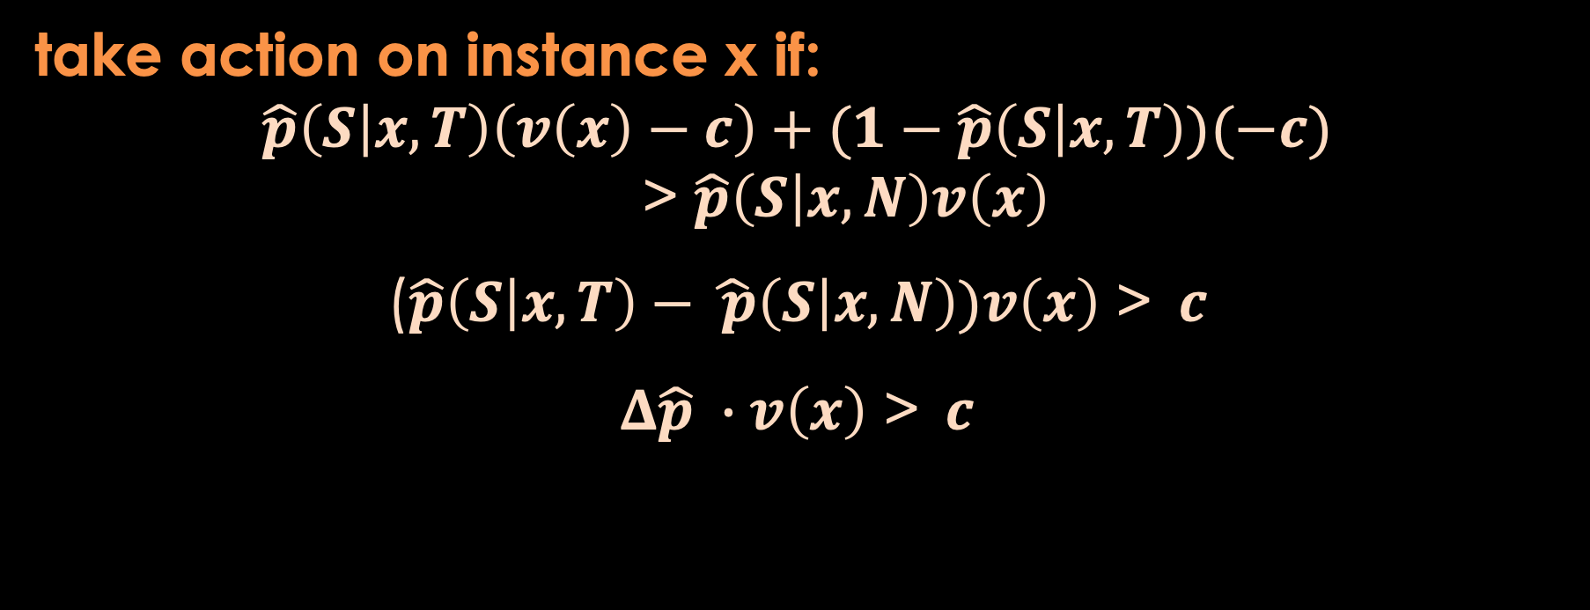
Here is the “expected value” framework for a binary action
take action on instance x if:
EV(act on x) > EV(don’t act on x)
v(x)-c
-c
v(x)
0
take action on instance x if:
$$\hat{p}\left(S | x,T\right)\left(v\left(x\right)−c\right)+(1−\hat{p}\left(S | x,T\right))(−c)$$
> $\hat{p}\left(S | x,N\right)v\left(x\right)$
($\hat{p}\left(S | x,T\right)−\hat{ p}\left(S | x,N\right))v\left(x\right)$ >$c$
$Δ\hat{p} ∙v\left(x\right)$ >$c$

Slide 12
Ok, so does this help with
the problem formulation complications?

Slide 13
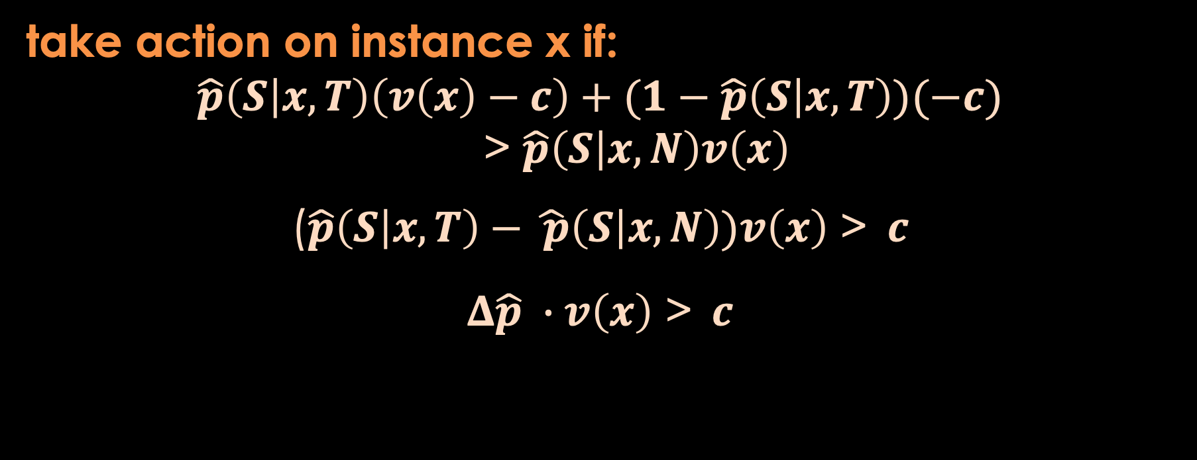
Here is the “expected value” framework for a binary action
take action on instance x if:
EV(act on x) > EV(don’t act on x)
v(x)-c
-c
v(x)
0
take action on instance x if:
$$\hat{p}\left(S | x,T\right)\left(v\left(x\right)−c\right)+(1−\hat{p}\left(S | x,T\right))(−c)$$
> $\hat{p}\left(S | x,N\right)v\left(x\right)$
($\hat{p}\left(S | x,T\right)−\hat{ p}\left(S | x,N\right))v\left(x\right)$ >$c$
$Δ\hat{p} ∙v\left(x\right)$ >$c$
Notes:
NOT SETTING UP ML HERE!

Slide 14

Attrition Management Complications . . . ?
If there is a non-negligible cost of making the offer, are we wasting a lot on people who are "lost causes"?
What about people who would have stayed, but then take the offer and that costs us?
What about sleeping dogs -- who would have stayed, but leave because of the offer?
Wouldn’t we we care more about some people churning? (Customer value) Maybe we even would like some to churn...?
What if we have a targeting budget?
Crazy, I know, but … should we offer different offers to different people?
See Chapter 11
Notes:
Help us to be more systematic when we face biz challenges and opps. The challenges faced are often complex – the frameworks help us to break these down into more manageable pieces and also to know what order to address the pieces.

Slide 15
Ok, so how does this guide our setting up our AI/ML?

Slide 16
So what about setting up the ML/AI for this formulation?
take action on instance x if:
EV(act on x) > EV(don’t act on x)
v(x)-c
-c
v(x)
0
take action on instance x if:
$$\hat{p}\left(S | x,T\right)\left(v\left(x\right)−c\right)+(1−\hat{p}\left(S | x,T\right))(−c)$$
> $\hat{p}\left(S | x,N\right)v\left(x\right)$
($\hat{p}\left(S | x,T\right)−\hat{ p}\left(S | x,N\right))v\left(x\right)$ >$c$
$Δ\hat{p} ∙v\left(x\right)$ >$c$
This is also our guide to setting up the AI/ML

Slide 17



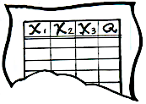
Use of AI for Inference: Two Models
Predicted
Quantity
1
X₁
X₂
X₃
Q
Model 1
Action
7
T
Red
?
Data Instance
Decision Logic
Predicted
Quantity
2
Model 2
Notes:
By the way, it doesn’t need to be just 2 models! In LTS we actually would like to recommend homes that would have the highest EV for our customers. We really should combine the likelihood of selling with the likelihood of the agent winning the listing with the value of the listing. (By the way, that’s what we are building now.)

Slide 18
So, that was actually ML for causal decision making –
for (causal) prescriptive analytics
Let’s think through exactly what that means.
Notes:
Distinguish from causal understanding? Distinguish from causal evaluation? Or wait on that for the A/B test extra at the end?

